Slide 1
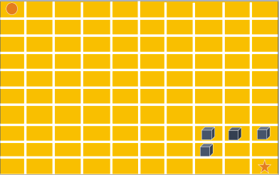
Amazon Code Challenge
Bright Network Internship, June 2022
JavaScript solution by Elena Porubin

Slide 2
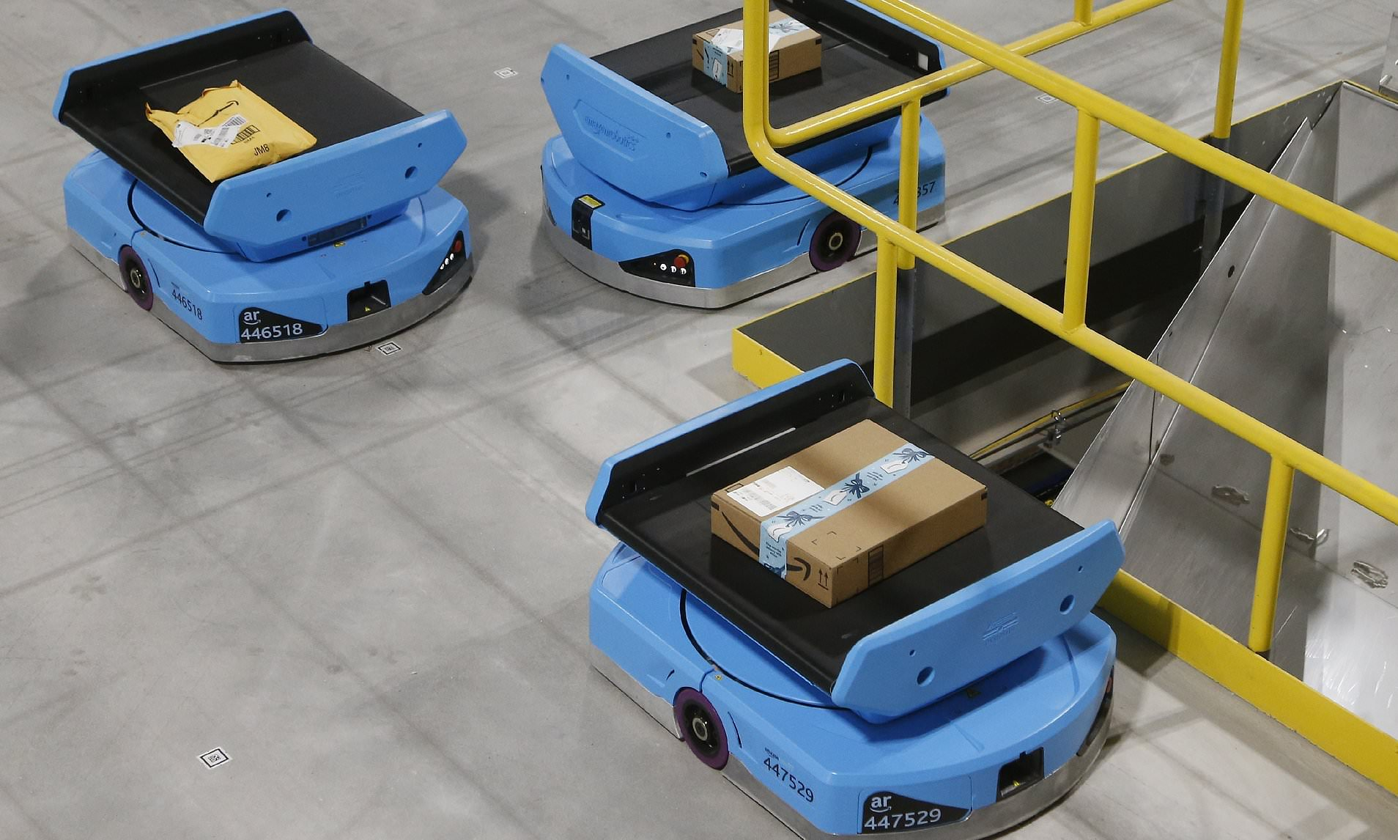
Introduction
The main aim of this code challenge was to implement an algorithm able to find the shortest path possible between two points in dependance of given constrains. In this presentation I would like to showcase my solution for Pathfinding on a 2D grid, implemented in JavaScript. Additionally, I would like to discuss the algorithm choice and bring up examples for Phase I and Phase II challenge`s solutions.

Slide 3
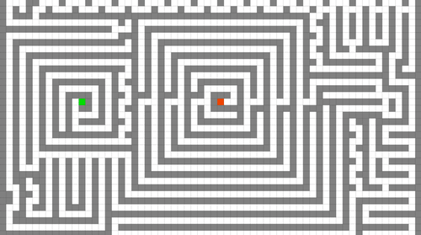
Algorithm choice
Lee algorithm based on breath-first search always gives an optimal solution, if one exists to pathfinding in maze routing problems.
Alternative method: A* Algorithm
Notes:
There is a wide variety of pathfinding algorithms which can provide a valuable solution for this problem, such as A*( A star), Dijkstra`s algorithm, sample algorithm. As we work on a 2D grid I approached the problem, associating the 2D grid with a maze, and therefore the starting point with the entrance, end point with the only valuable exit and the obstacles and grid margins to the maze walls and applied Lee`s algorithm for pathfinding in a maze to solve this challenge. As we can see in the animation this algorithm would flood in all possible ways and calculate the amount of step required to achieve the destination for every current position in dependance of previously available options. A* algorithm proves to be faster in the average cases of shortest path finding but requires more complex distance calculations, therefore due to short time provided to sort this challenge I have chosen to implement the lee algorithm as I was able to understand it better.

Slide 4
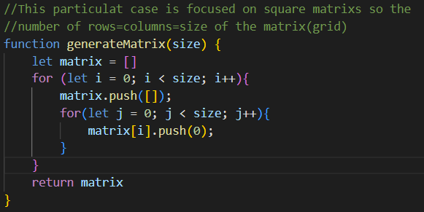
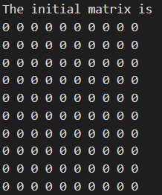
Phase I
1st Stage: Assumption that a 2D grid of size 10x10 can be represented as matrix composed from 10 rows each rows containing 10 columns.
2nd Stage: Generate the matrix using an array of arrays in JavaScript
The 2d grid has fixed obstacle positions

Slide 5
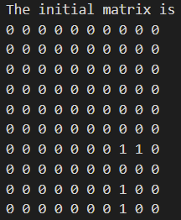
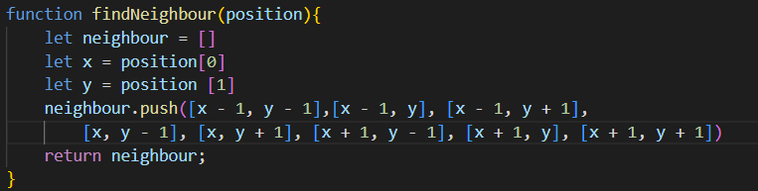
Phase I
The 2d grid has fixed obstacle positions
3rd Stage: Given the coordinates of the obstacles mark them on the matrix with value “1” and create the grid
4th Stage find every current position neighbors, based on available spaces in the grid in 2D space.

Slide 6
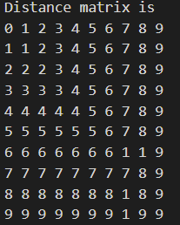
Phase I
5th Stage: Create a plan distance matrix to store the min number of steps required to achieve a neighbor.
6th Stage: Flood the matrix using queue principle of adding new available spots to the end and removing the visited spots from the beginning and record the distance between points in the distance matrix
The 2d grid has fixed obstacle positions

Slide 7
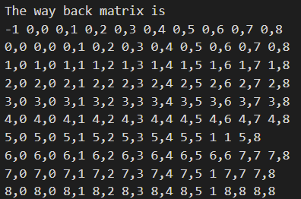
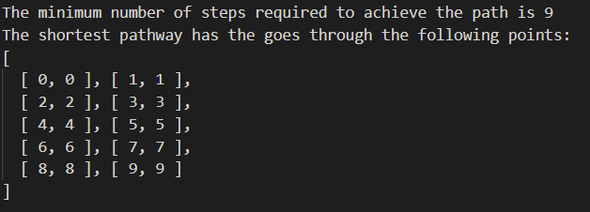
Phase I
7th Stage: Record in another array the positions from the shortest path it`s coming from and the amount
8th Stage display the number of steps required to achieve the end point and the fastest path coordinates
The 2d grid has fixed obstacle positions

Slide 8
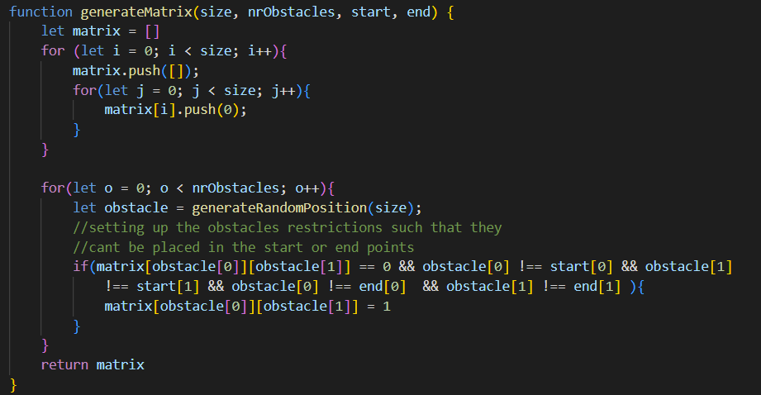
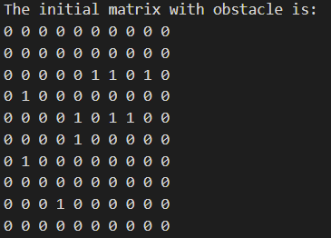
Phase II
1st and 2nd Stage would be similar as Phase 1 to create the matrix module
3rd Stage: To generate random points and mark them on the matrix
The 2d grid has 20 random allocated obstacles

Slide 9
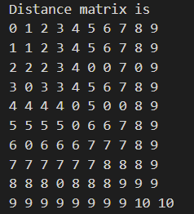
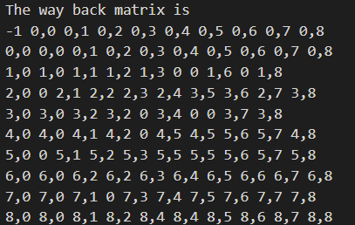
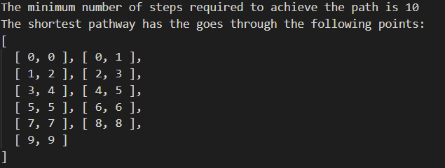
Phase II
4th Stage: Find the neighbors and create the distance matrix
5th Stage: Flood the matrix and find the shortest amount of step required and the path coordinates using the same path Back array from Phase I
The 2d grid has 20 random allocated obstacles
Notes:
Please not that the obstacles are generated random every time the program is running and therefore everytime there would be a different matrix

Slide 10

Summary
Lee algorithm with breadth-first search proved to be a suitable method to find the shortest path on a 2D grid. Moreover, the solution takes in consideration all phase I and phase II constrains and selects the shortest paths based on the shortest distance required between neighbors.

Slide 11

Thank You
Source code Git Hub
Let`s connect on LinkedIn

